Slide 1

Heart Disease Prediction Using Machine Learning
EAI 6000: Fundamentals of Artificial Intelligence Final Project Submission
Name: Jaykumar Bhingaradia

Slide 2
AIM :
Cardiovascular disease claims the lives of one person every 37 seconds in the United States.
Heart disease claims the lives of over 647,000 Americans each year, or one out of every four people.
In the years 2014 and 2015, heart disease cost the US $219 billion. This covers the expense of medical services, medications, and lost productivity as a result of mortality

Slide 3
Problem Statement
Complete analysis of Heart Disease UCI dataset both visually and statistically to obtain critical observations which can be used for inference.
To predict whether a person has a heart disease or not based on the various biological and physical parameters of the body
To make a model having high accuracy and precision and can predict the results with greater confidence.
Make these predictions accessible to users and patients anywhere, anytime so that they can get complete picture of their Health

Slide 4
DATASET INTRODUCTION
age
sex
cp
trestbps
chol
fbs
restecg
thalach
exang
oldpeak
slope
ca
thal
target

Slide 5
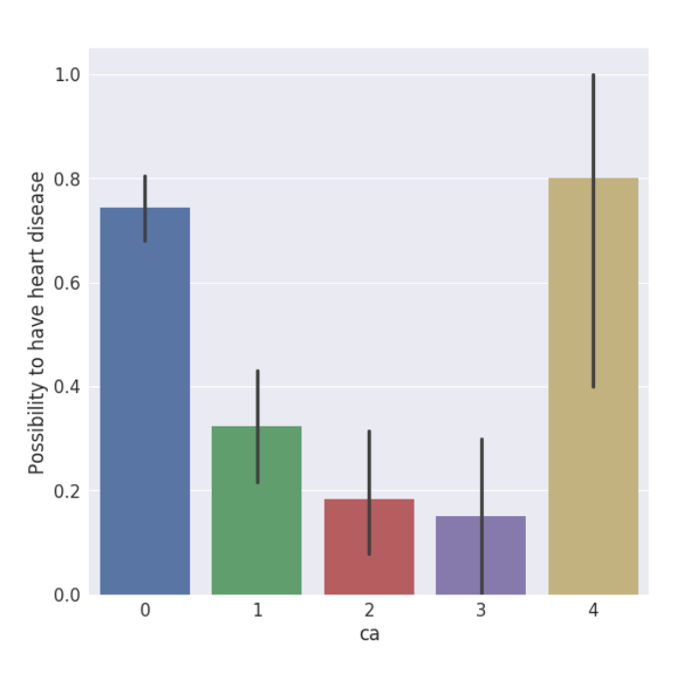
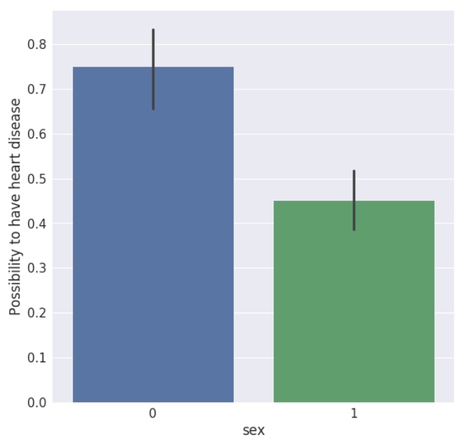
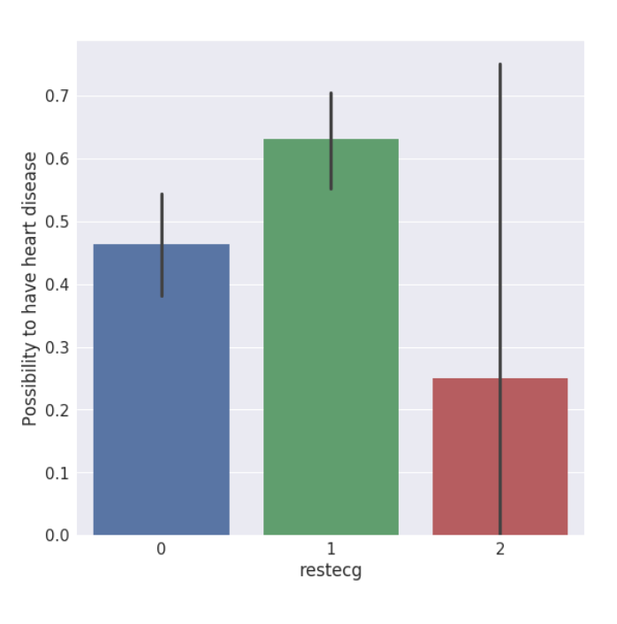
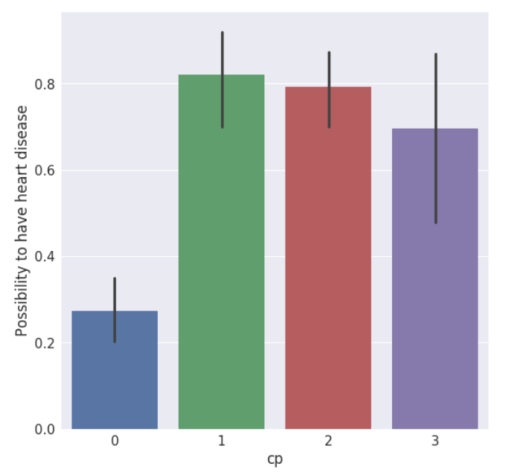
KEY FINDING
restecg {resting EKG results}: People with a value of 1 are more likely to have heart disease.
cp {Chest pain}: People with cp 1, 2, 3 are more likely to have heart disease than people with cp 0.
ca {number of major vessels (0-3) stained by fluoroscopy}: the more blood movement the better, so people with ca equal to 0 are more likely to have heart disease.
SEX {Male/Female} : Male are more likely to have heart disease than Female.

Slide 6
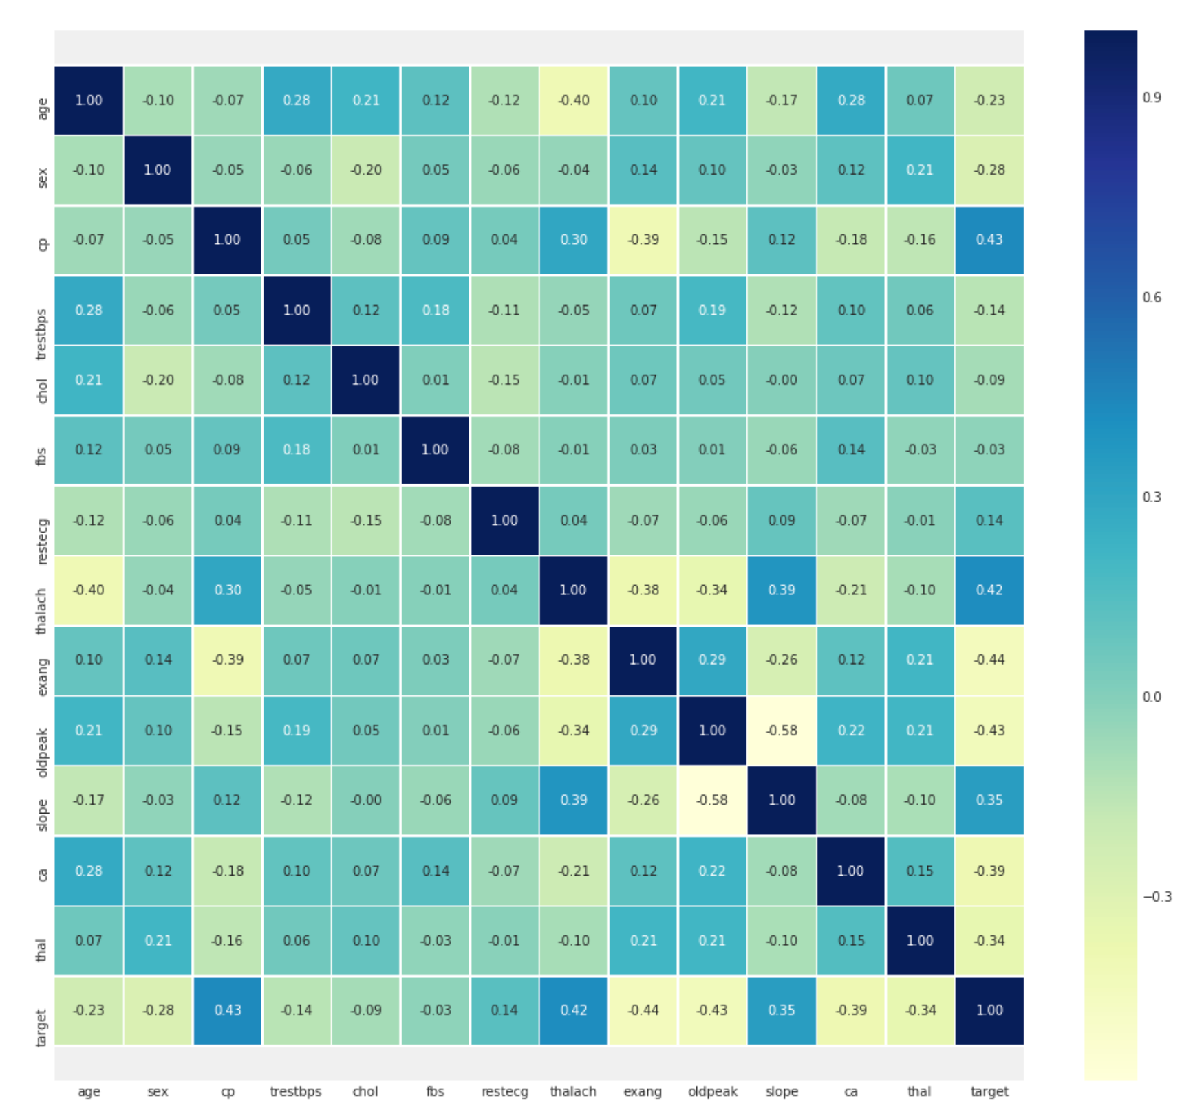
Correlation Matrix
1. fbs and chol are the least correlated with the target variable.
2. All other variables have a significant correlation with the target variable.

Slide 7
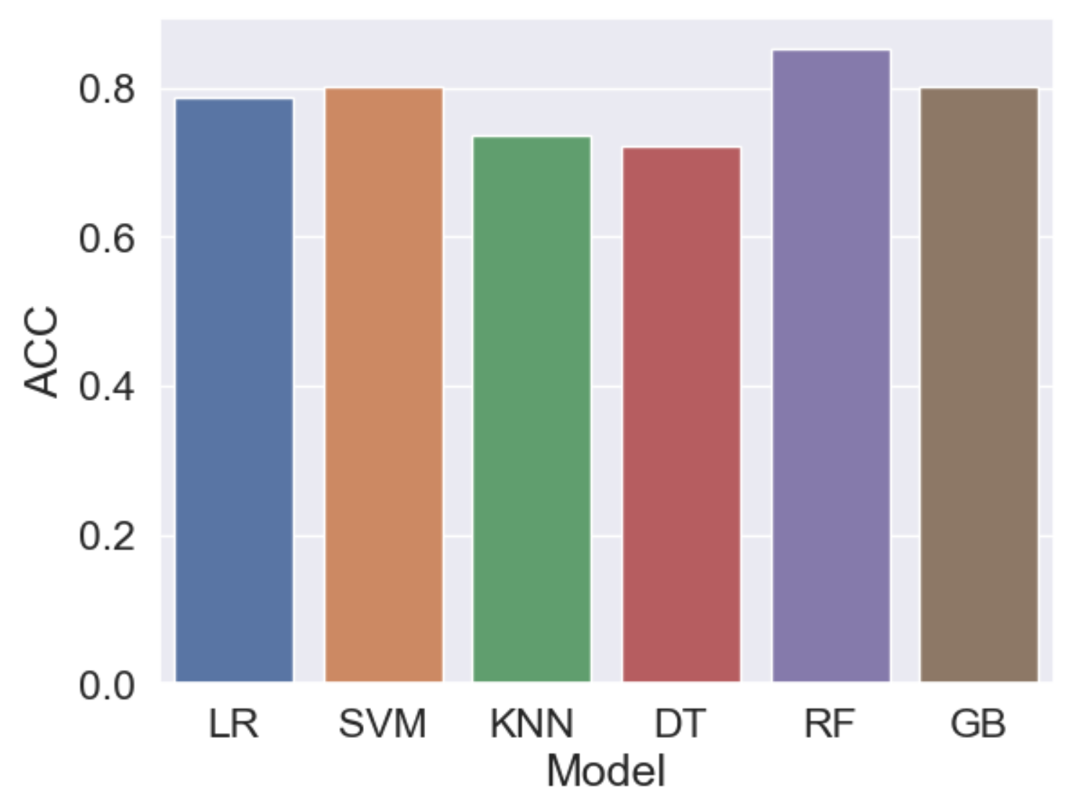
Model Selection
Model | ACC
Logistic Regression | 0.786885
SVC | 0.803279
Kneighbors Classifier | 0.737705
Decision Tree Classifier | 0.721311
Random Forest Classifier | 0.852459
Gradient Boosting Classifier | 0.803279

Slide 8
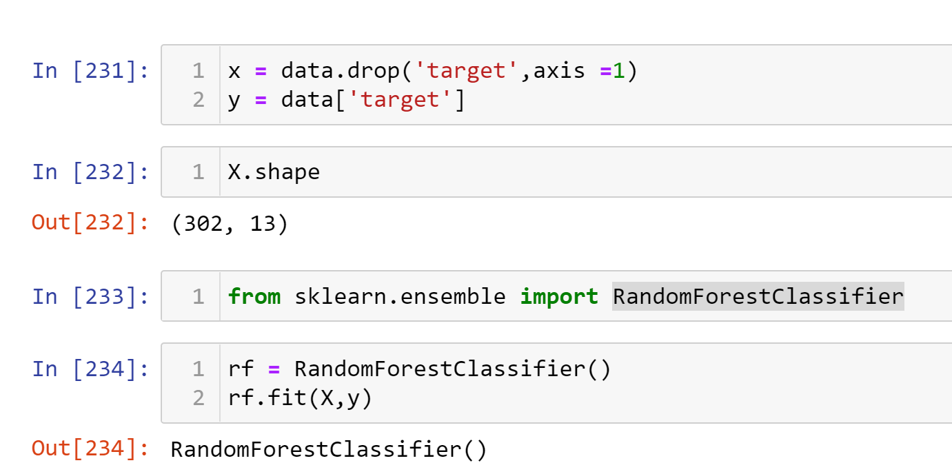
Random Forest Classifier

Slide 9
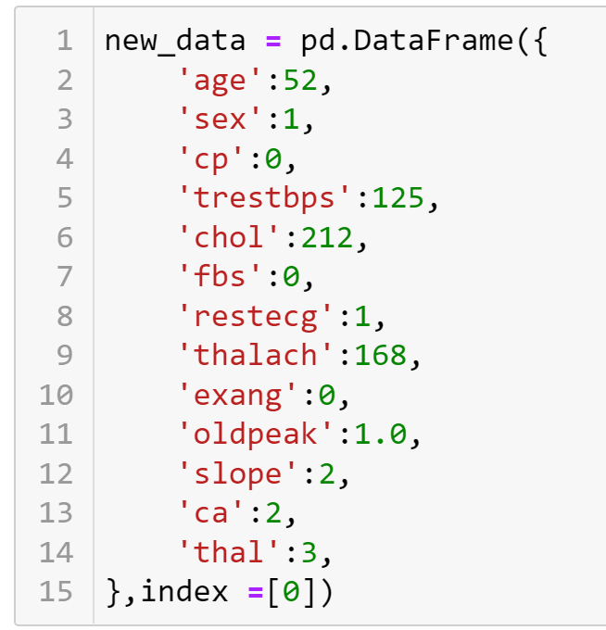
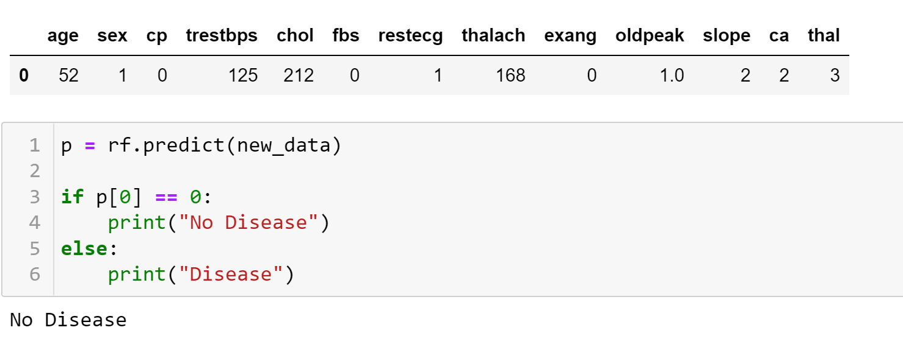
Prediction Data

Slide 10
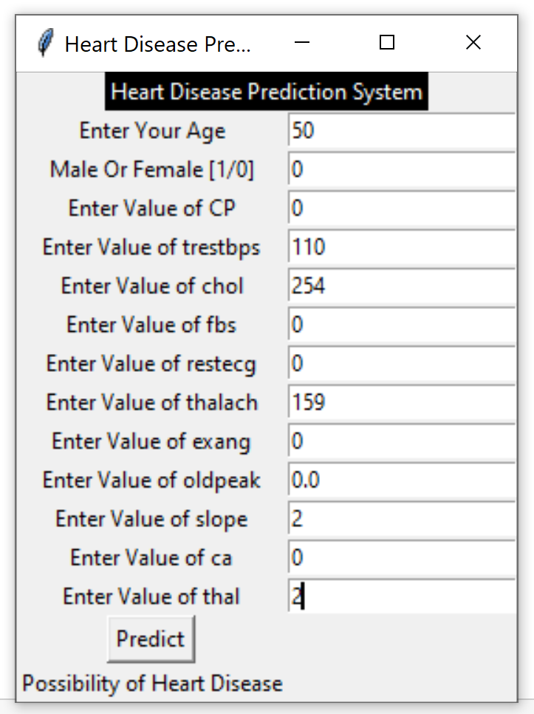
GUI (Graphical User Interface)

Slide 11
Conclusion
Heart disease is one of society's key worries nowadays. Manually calculating the chances of developing heart disease based on risk factors is tough.
However, utilizing Machine Learning, we can quickly determine whether the person has heart disease. Doctors will give adequate therapy to patients and save their lives due to the rapid and precise categorization of heart disease.

